Slide 1


A guide to debugging apps

Slide 2
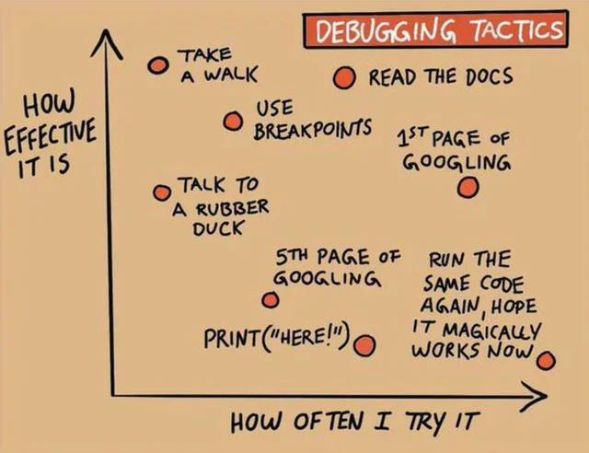

Slide 3
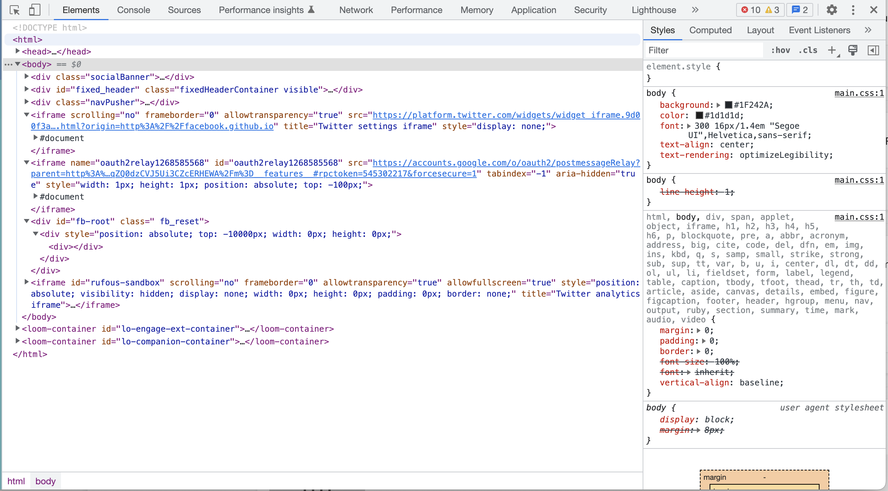
Debugging web

Slide 4
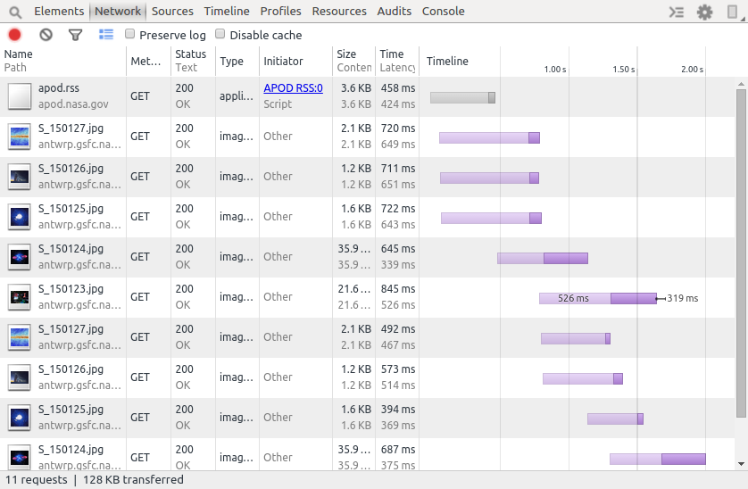
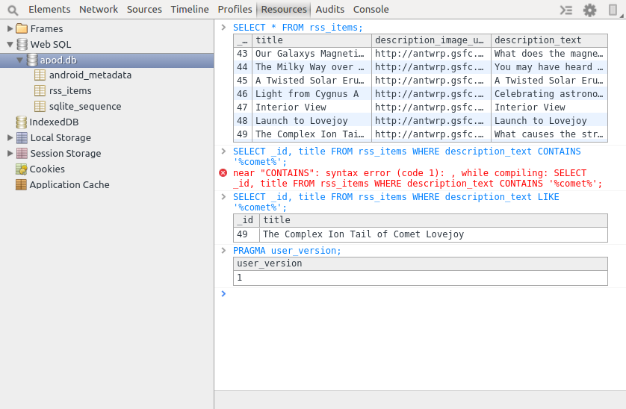
Facebook stetho

Slide 5

Debugging mobile apps with Flipper

Slide 6
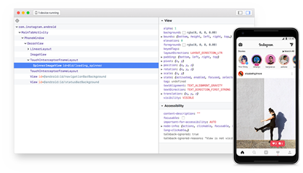
What is Flipper?
Mobile app debugger
Extensible via Plugins
Open Source
Made by Facebook
Targeted to mobile apps
Android
iOS
React Native

Slide 7
WHY flipper?
No IDE required
Testers and users can debug/view app
Replay sessions
Export/Import files
Platform agnostic
Support your own OS?
Out-of-the-box plugins

Slide 8
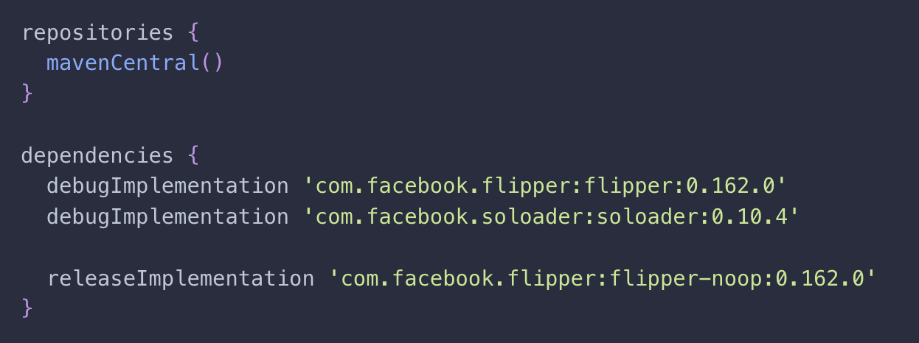
How to use flipper in your app

Slide 9
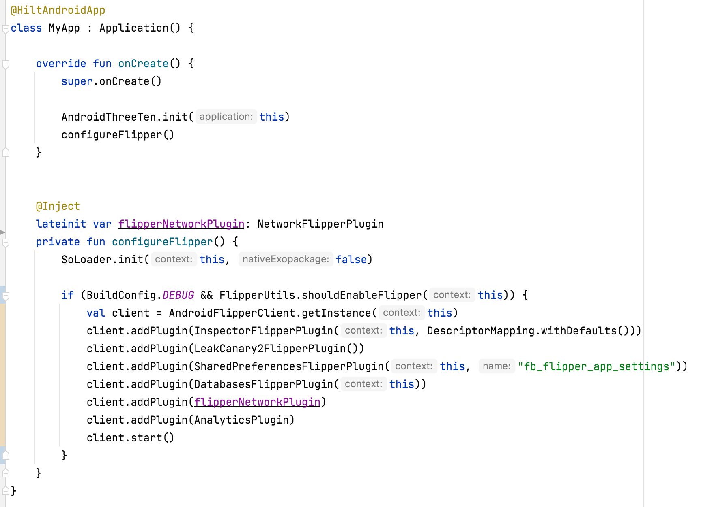
How to use flipper in your app

Slide 10
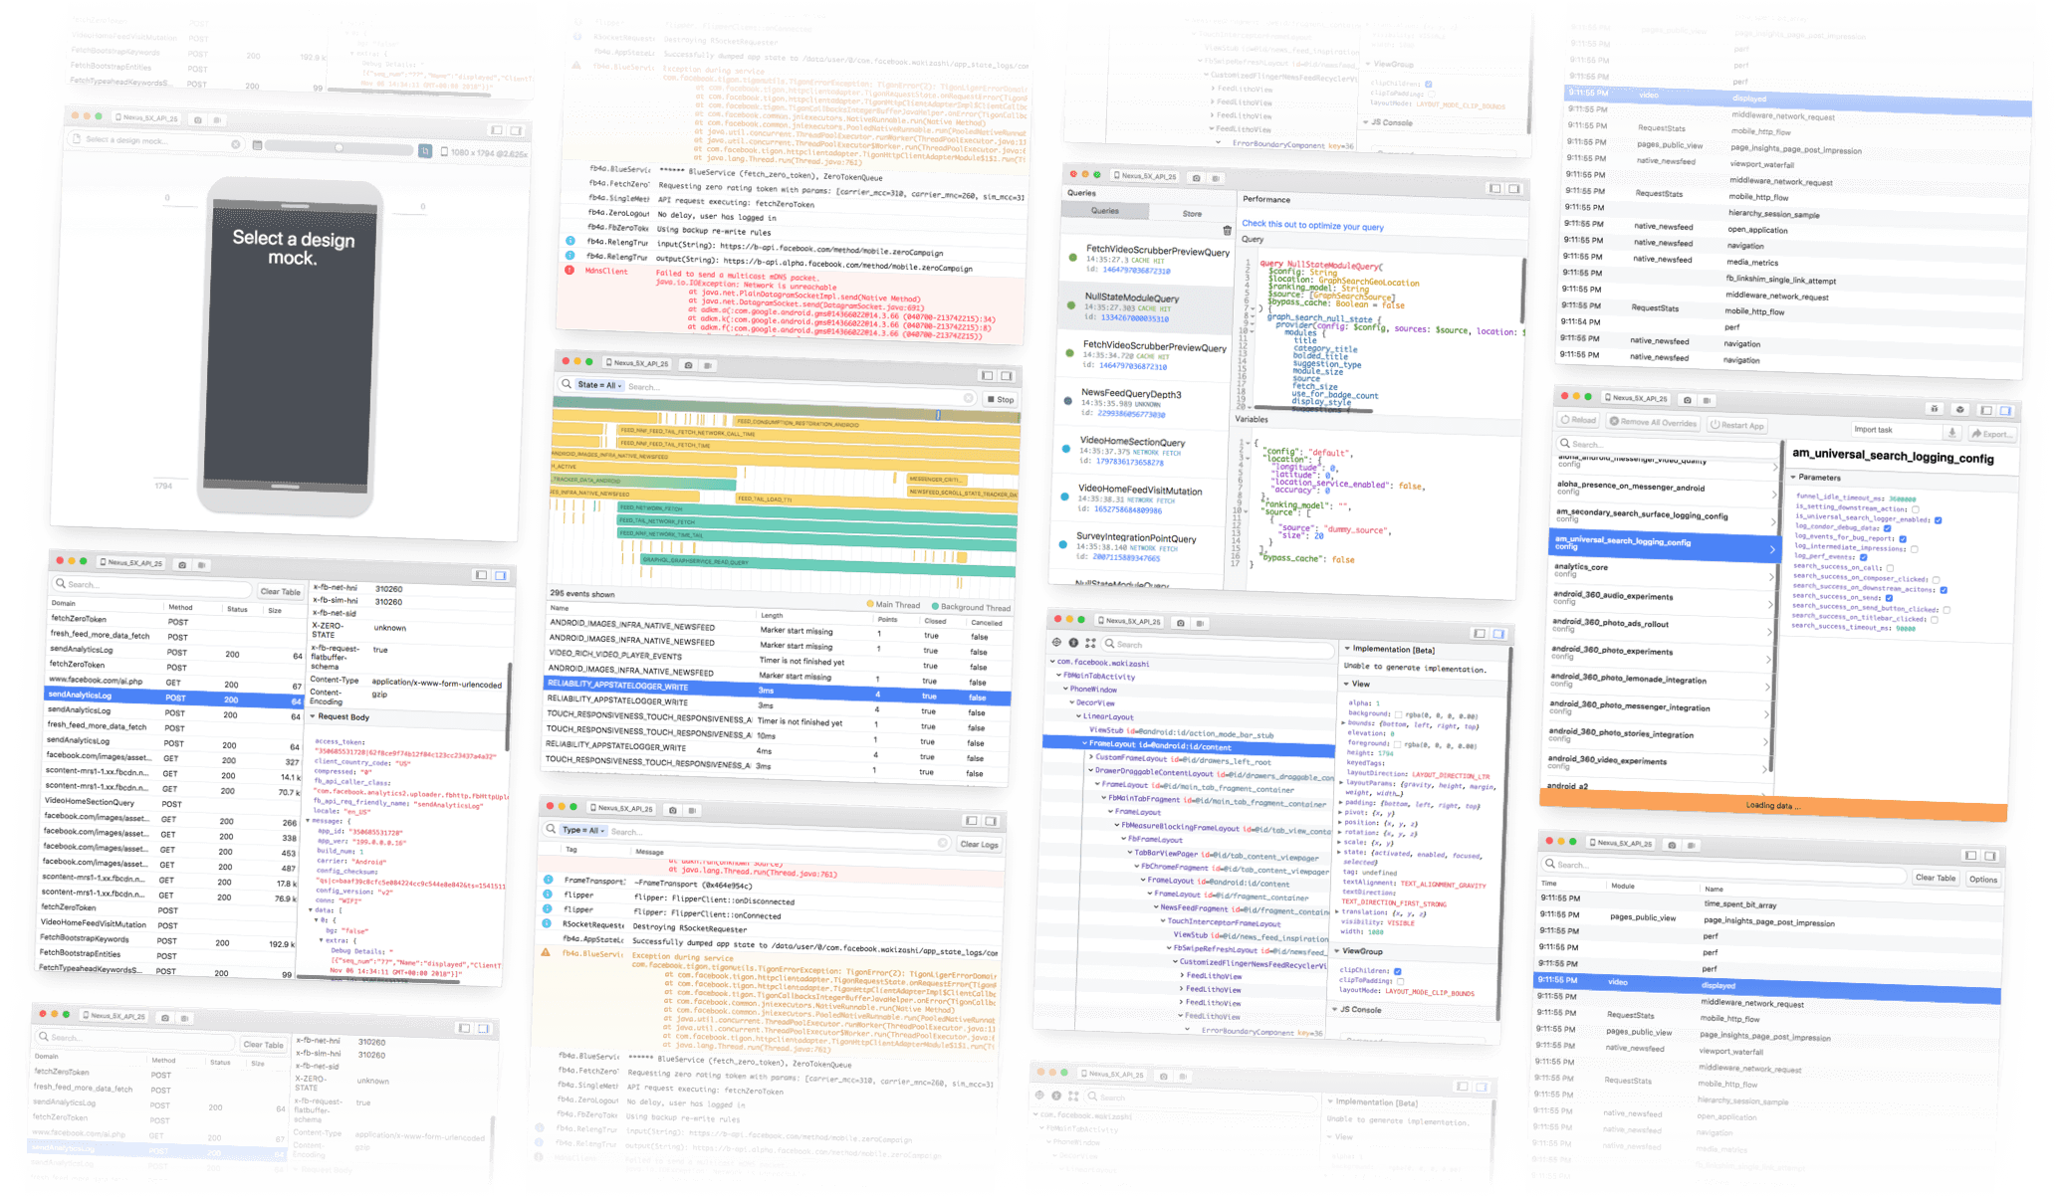
Out-of-the-box plugins
Crash Reporter
Databases
Logs
Images
Layout
LeakCanary
Navigation
Shared Preferences Viewer

Slide 11
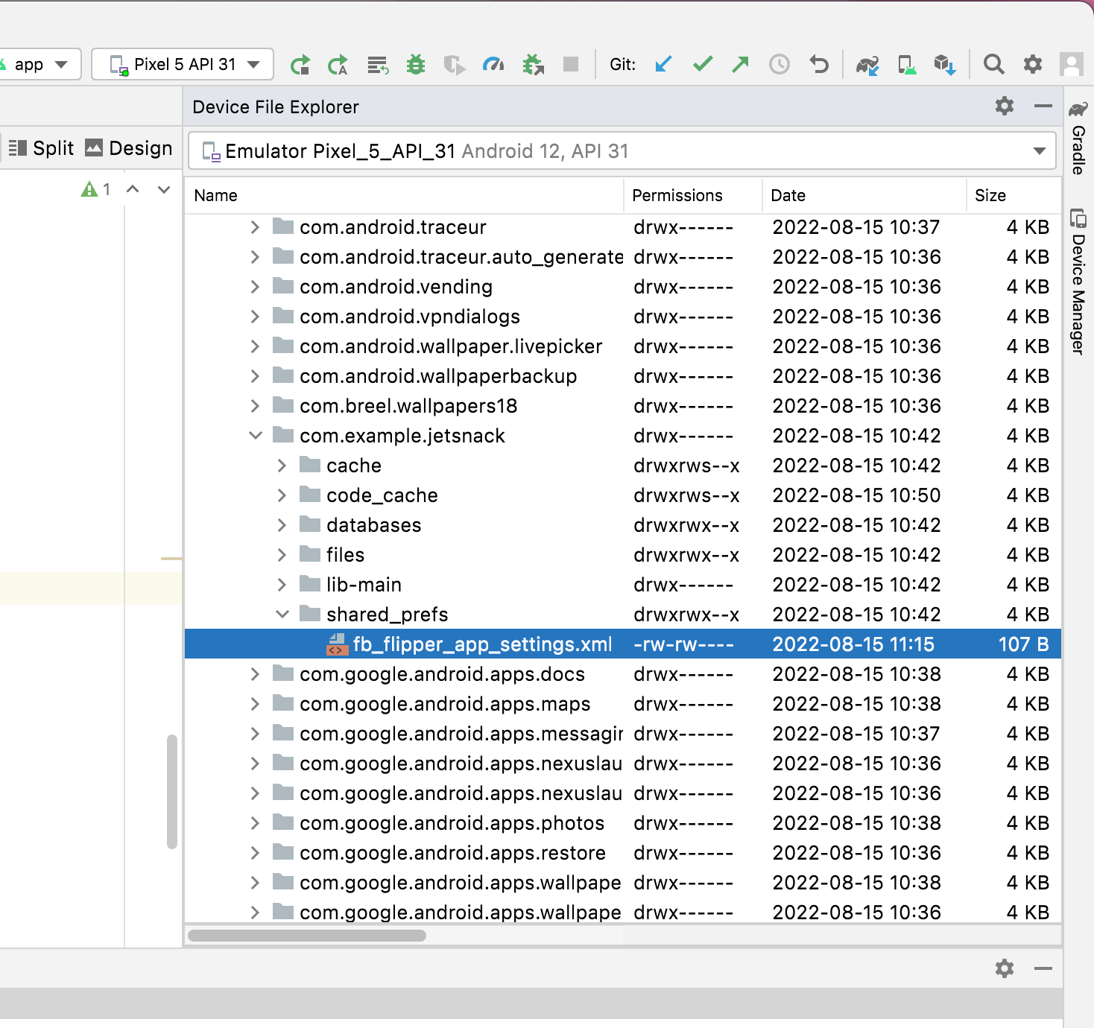
Shared preferences (Android)
Find the file in Device Explorer (only from IDE)
/data/data/com.example.app/shared_prefs/file.xml

Slide 12
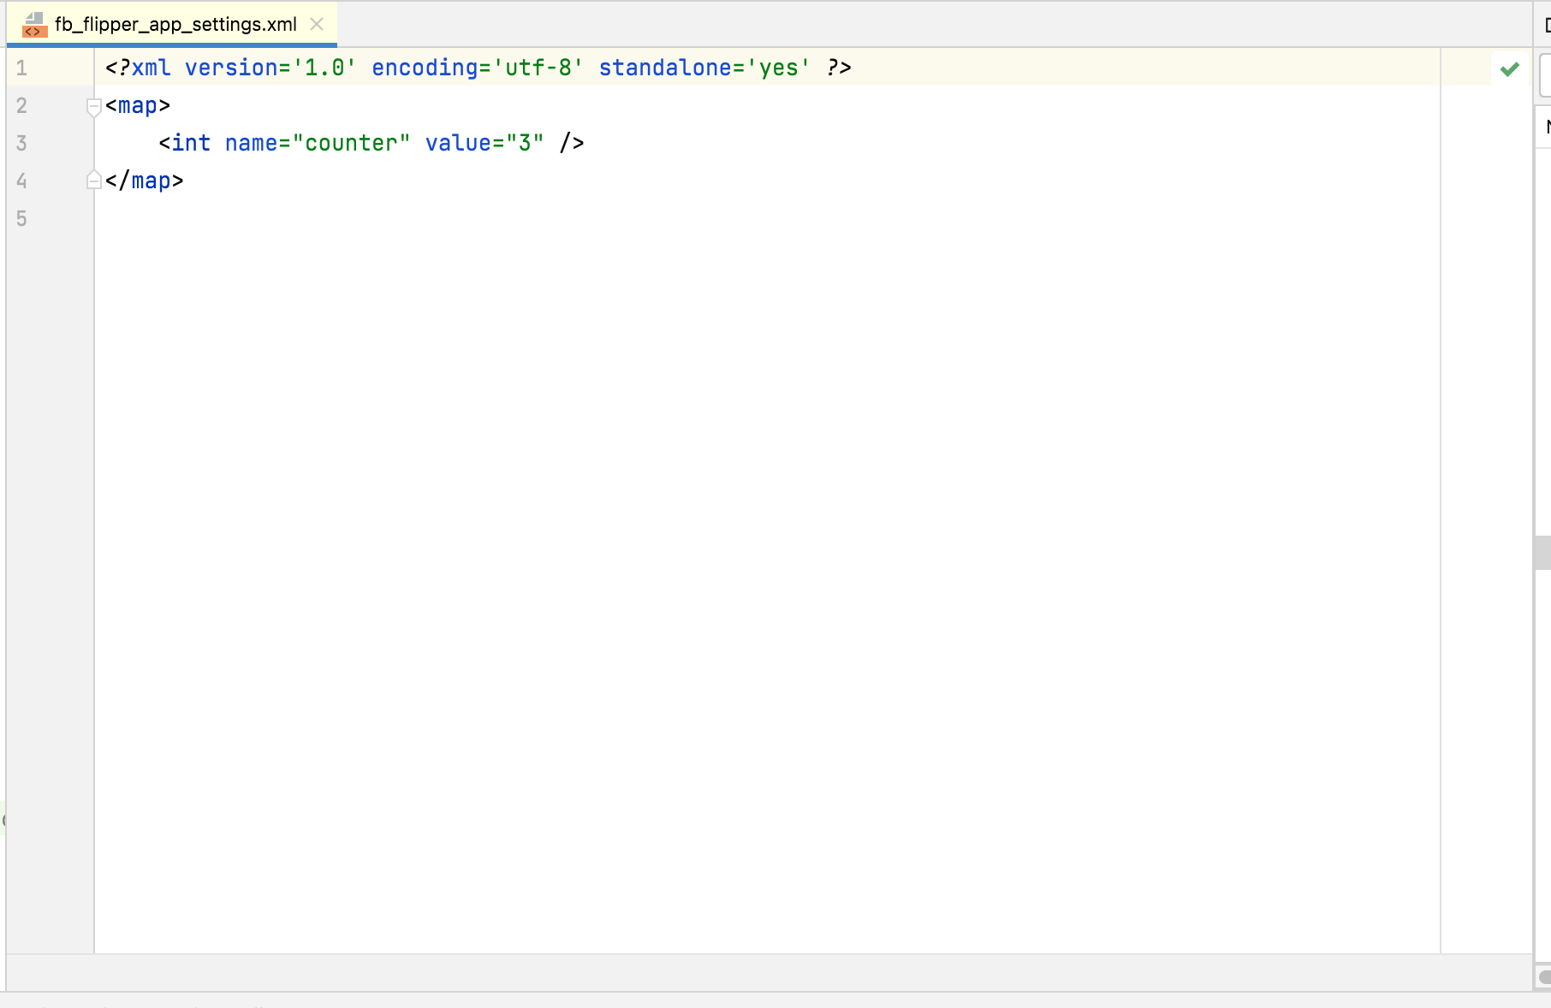
Shared preferences (Android)
Find the file in Device Explorer (only from IDE)
Open the file

Slide 13

Shared preferences (Android)
Find the file in Device Explorer (only from IDE)
Open the file
Refresh the file manually for every change

Slide 14
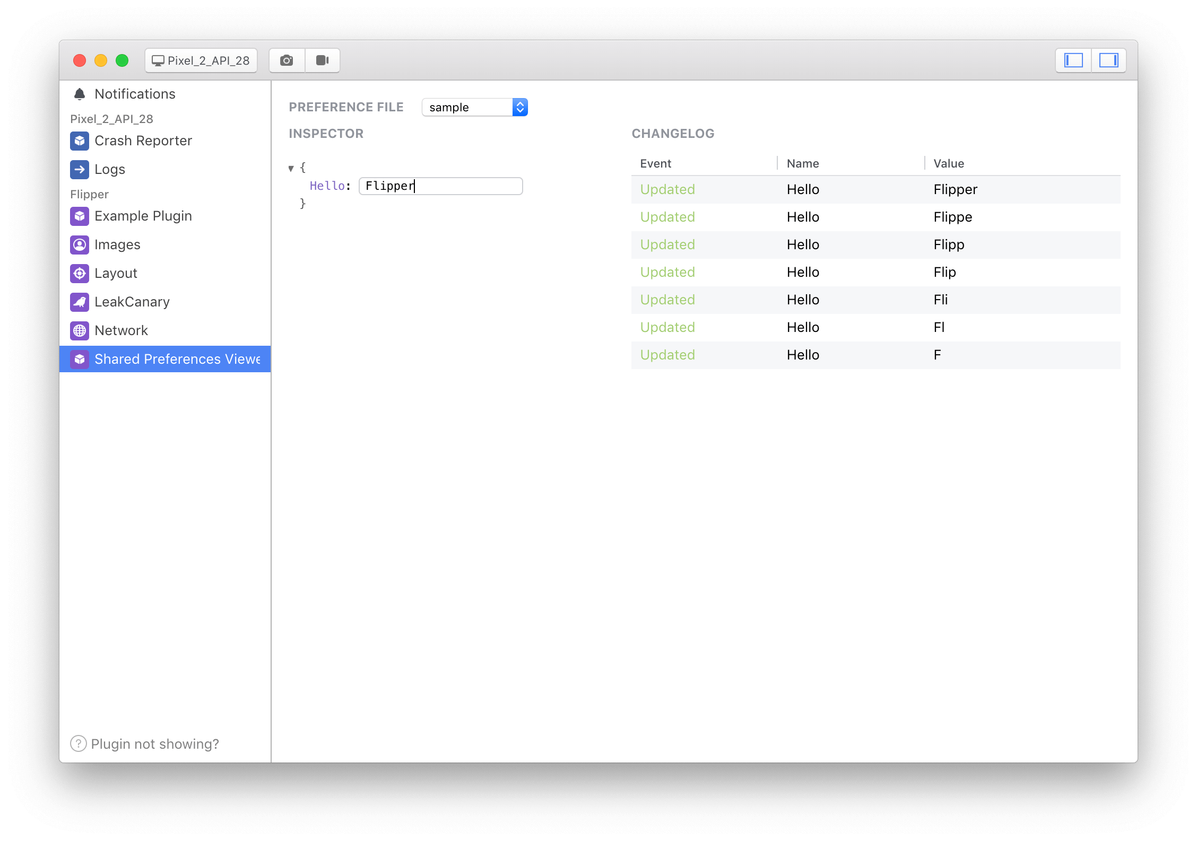

Shared preferences (Flipper)

Slide 15
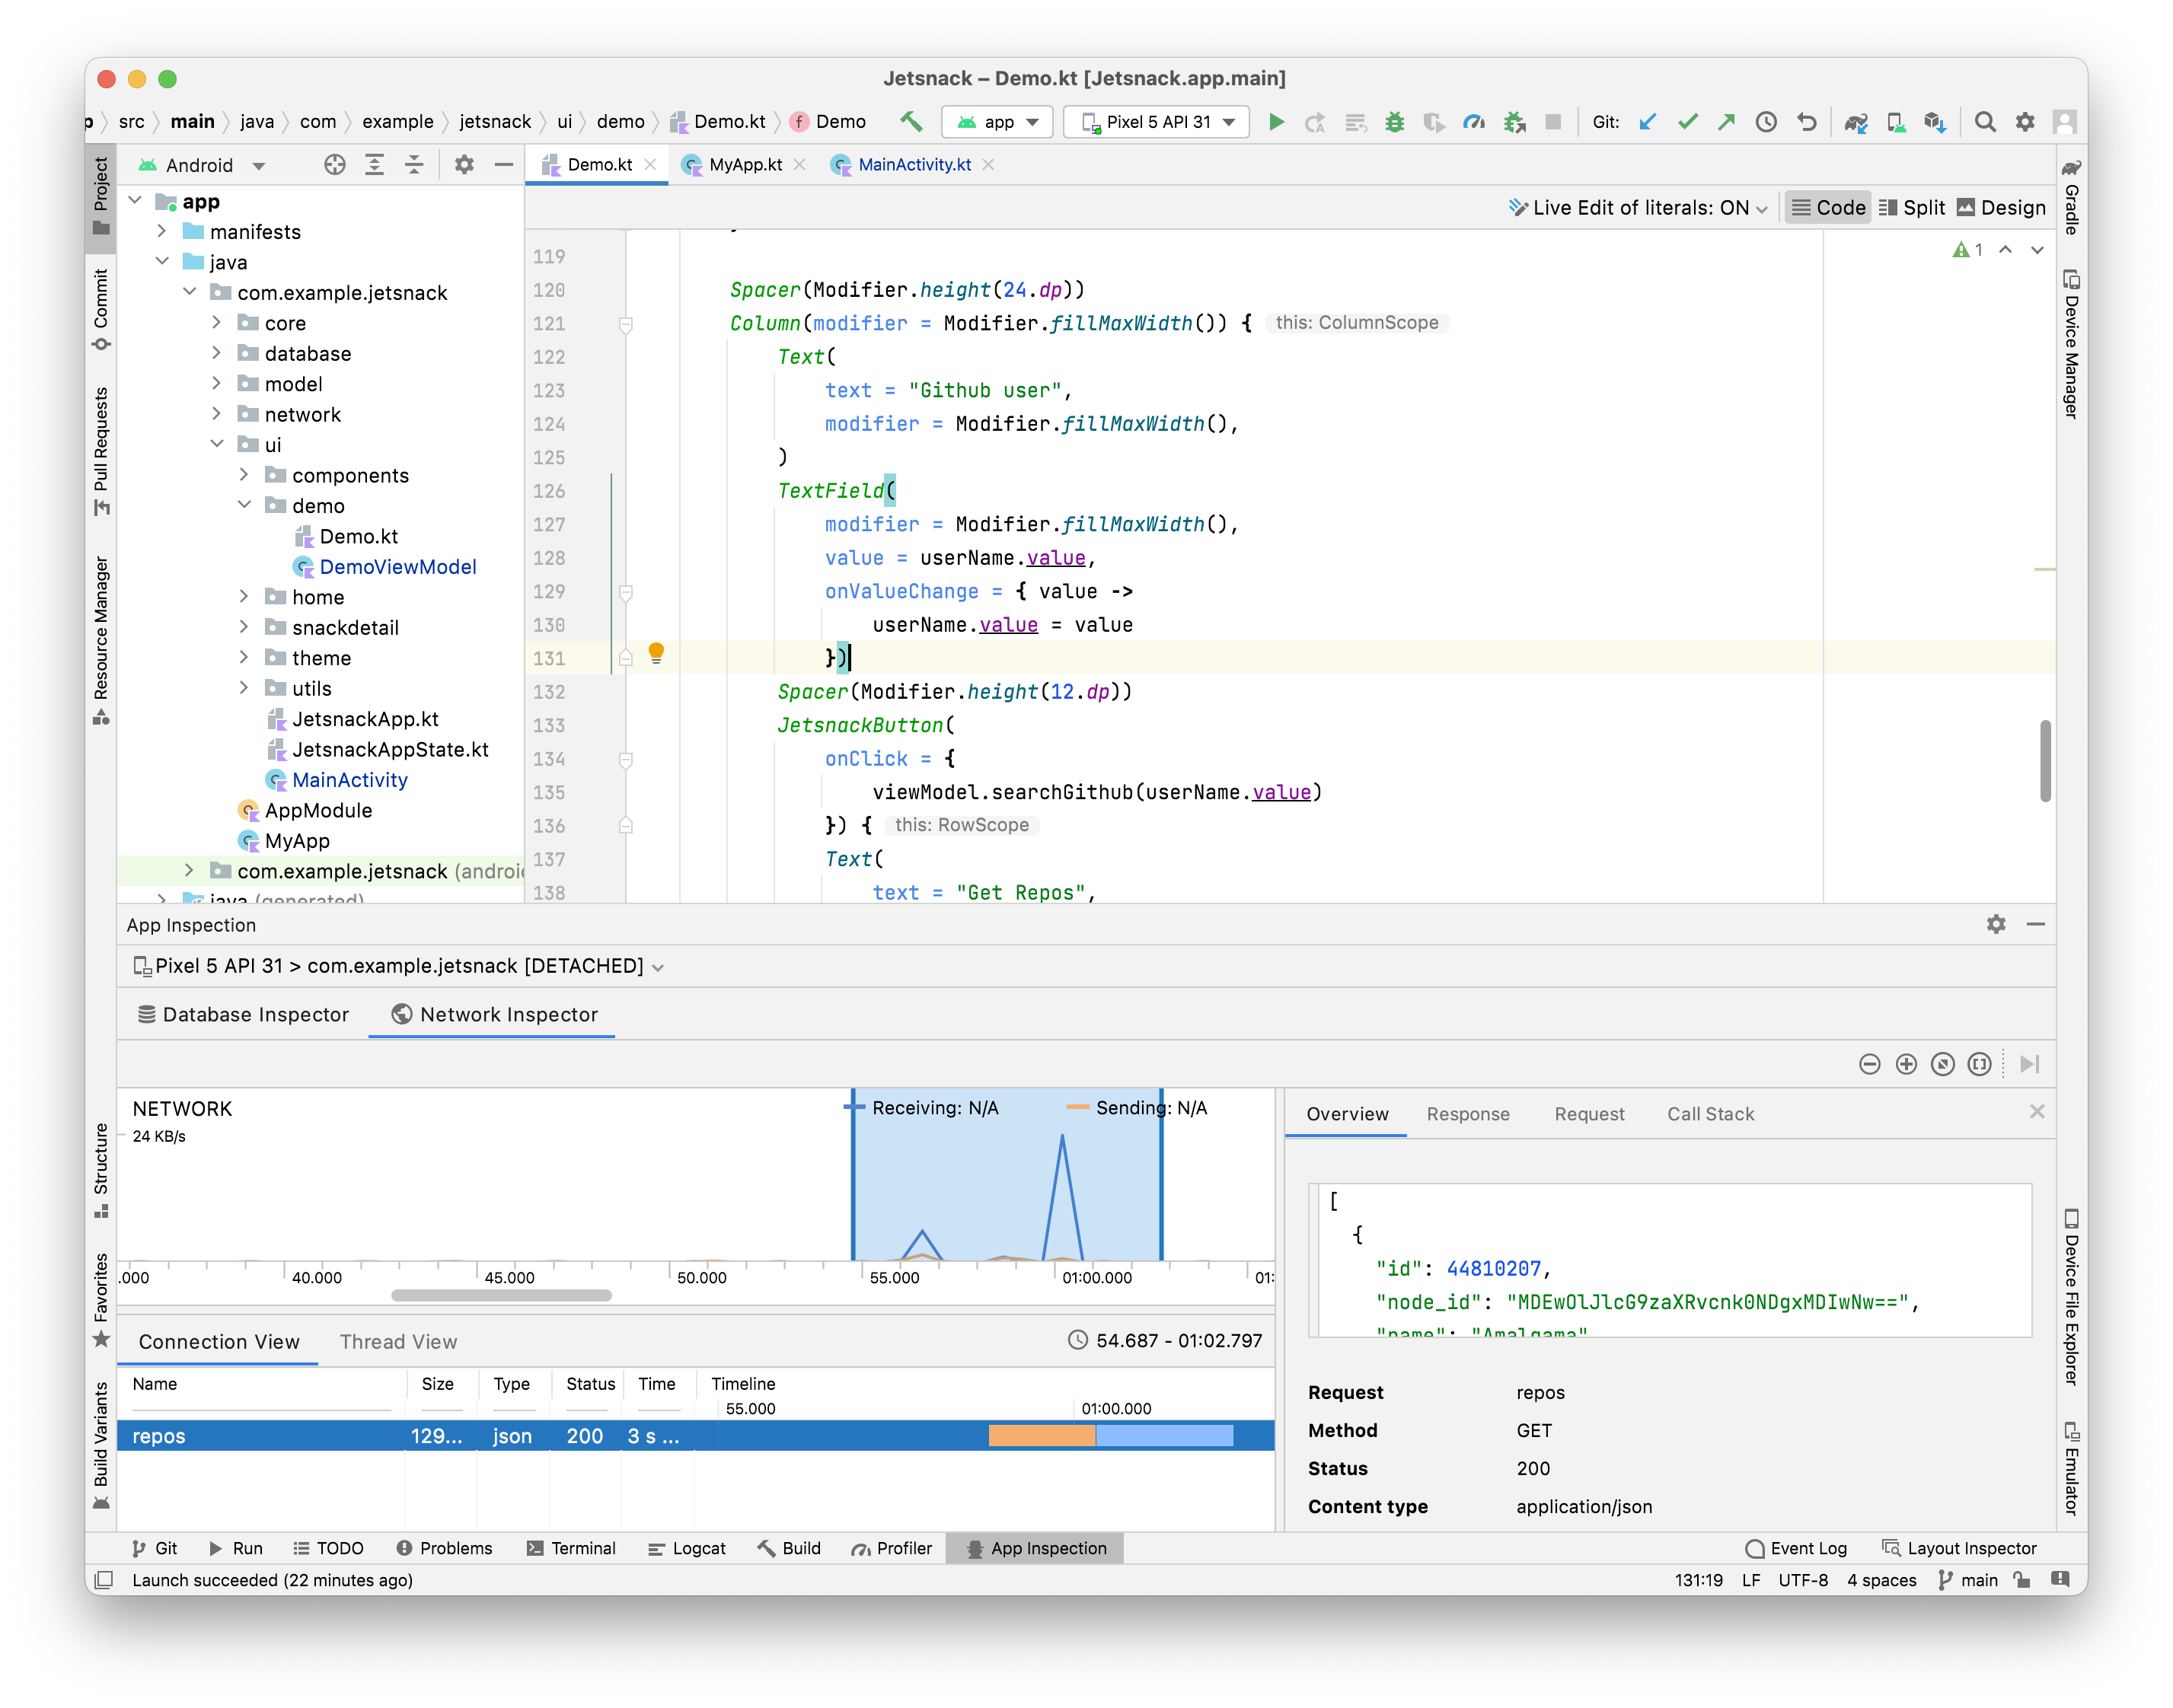
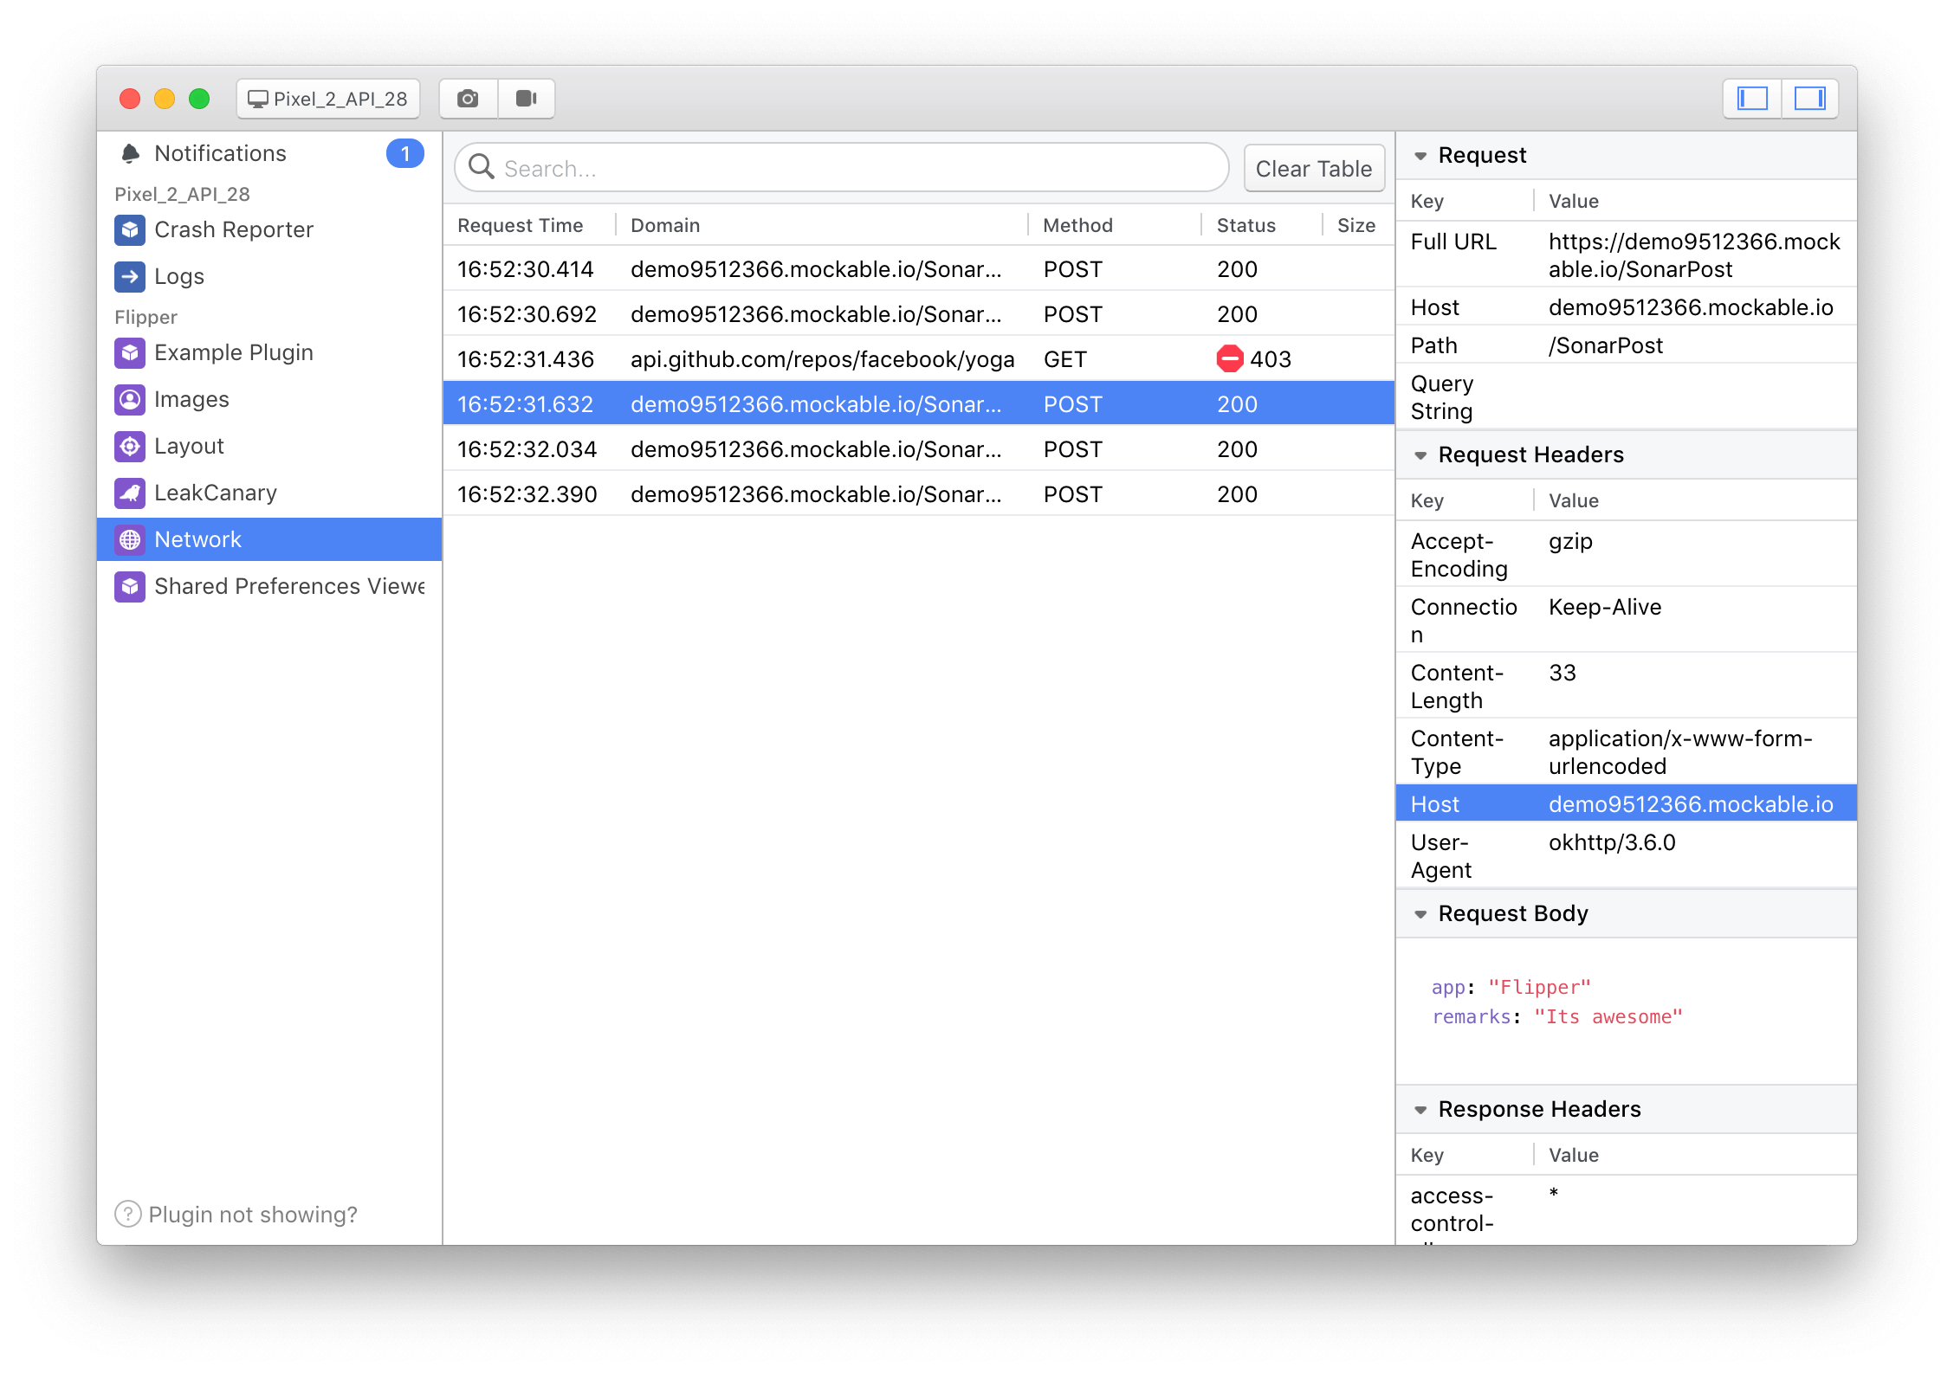
Network Request

Slide 16
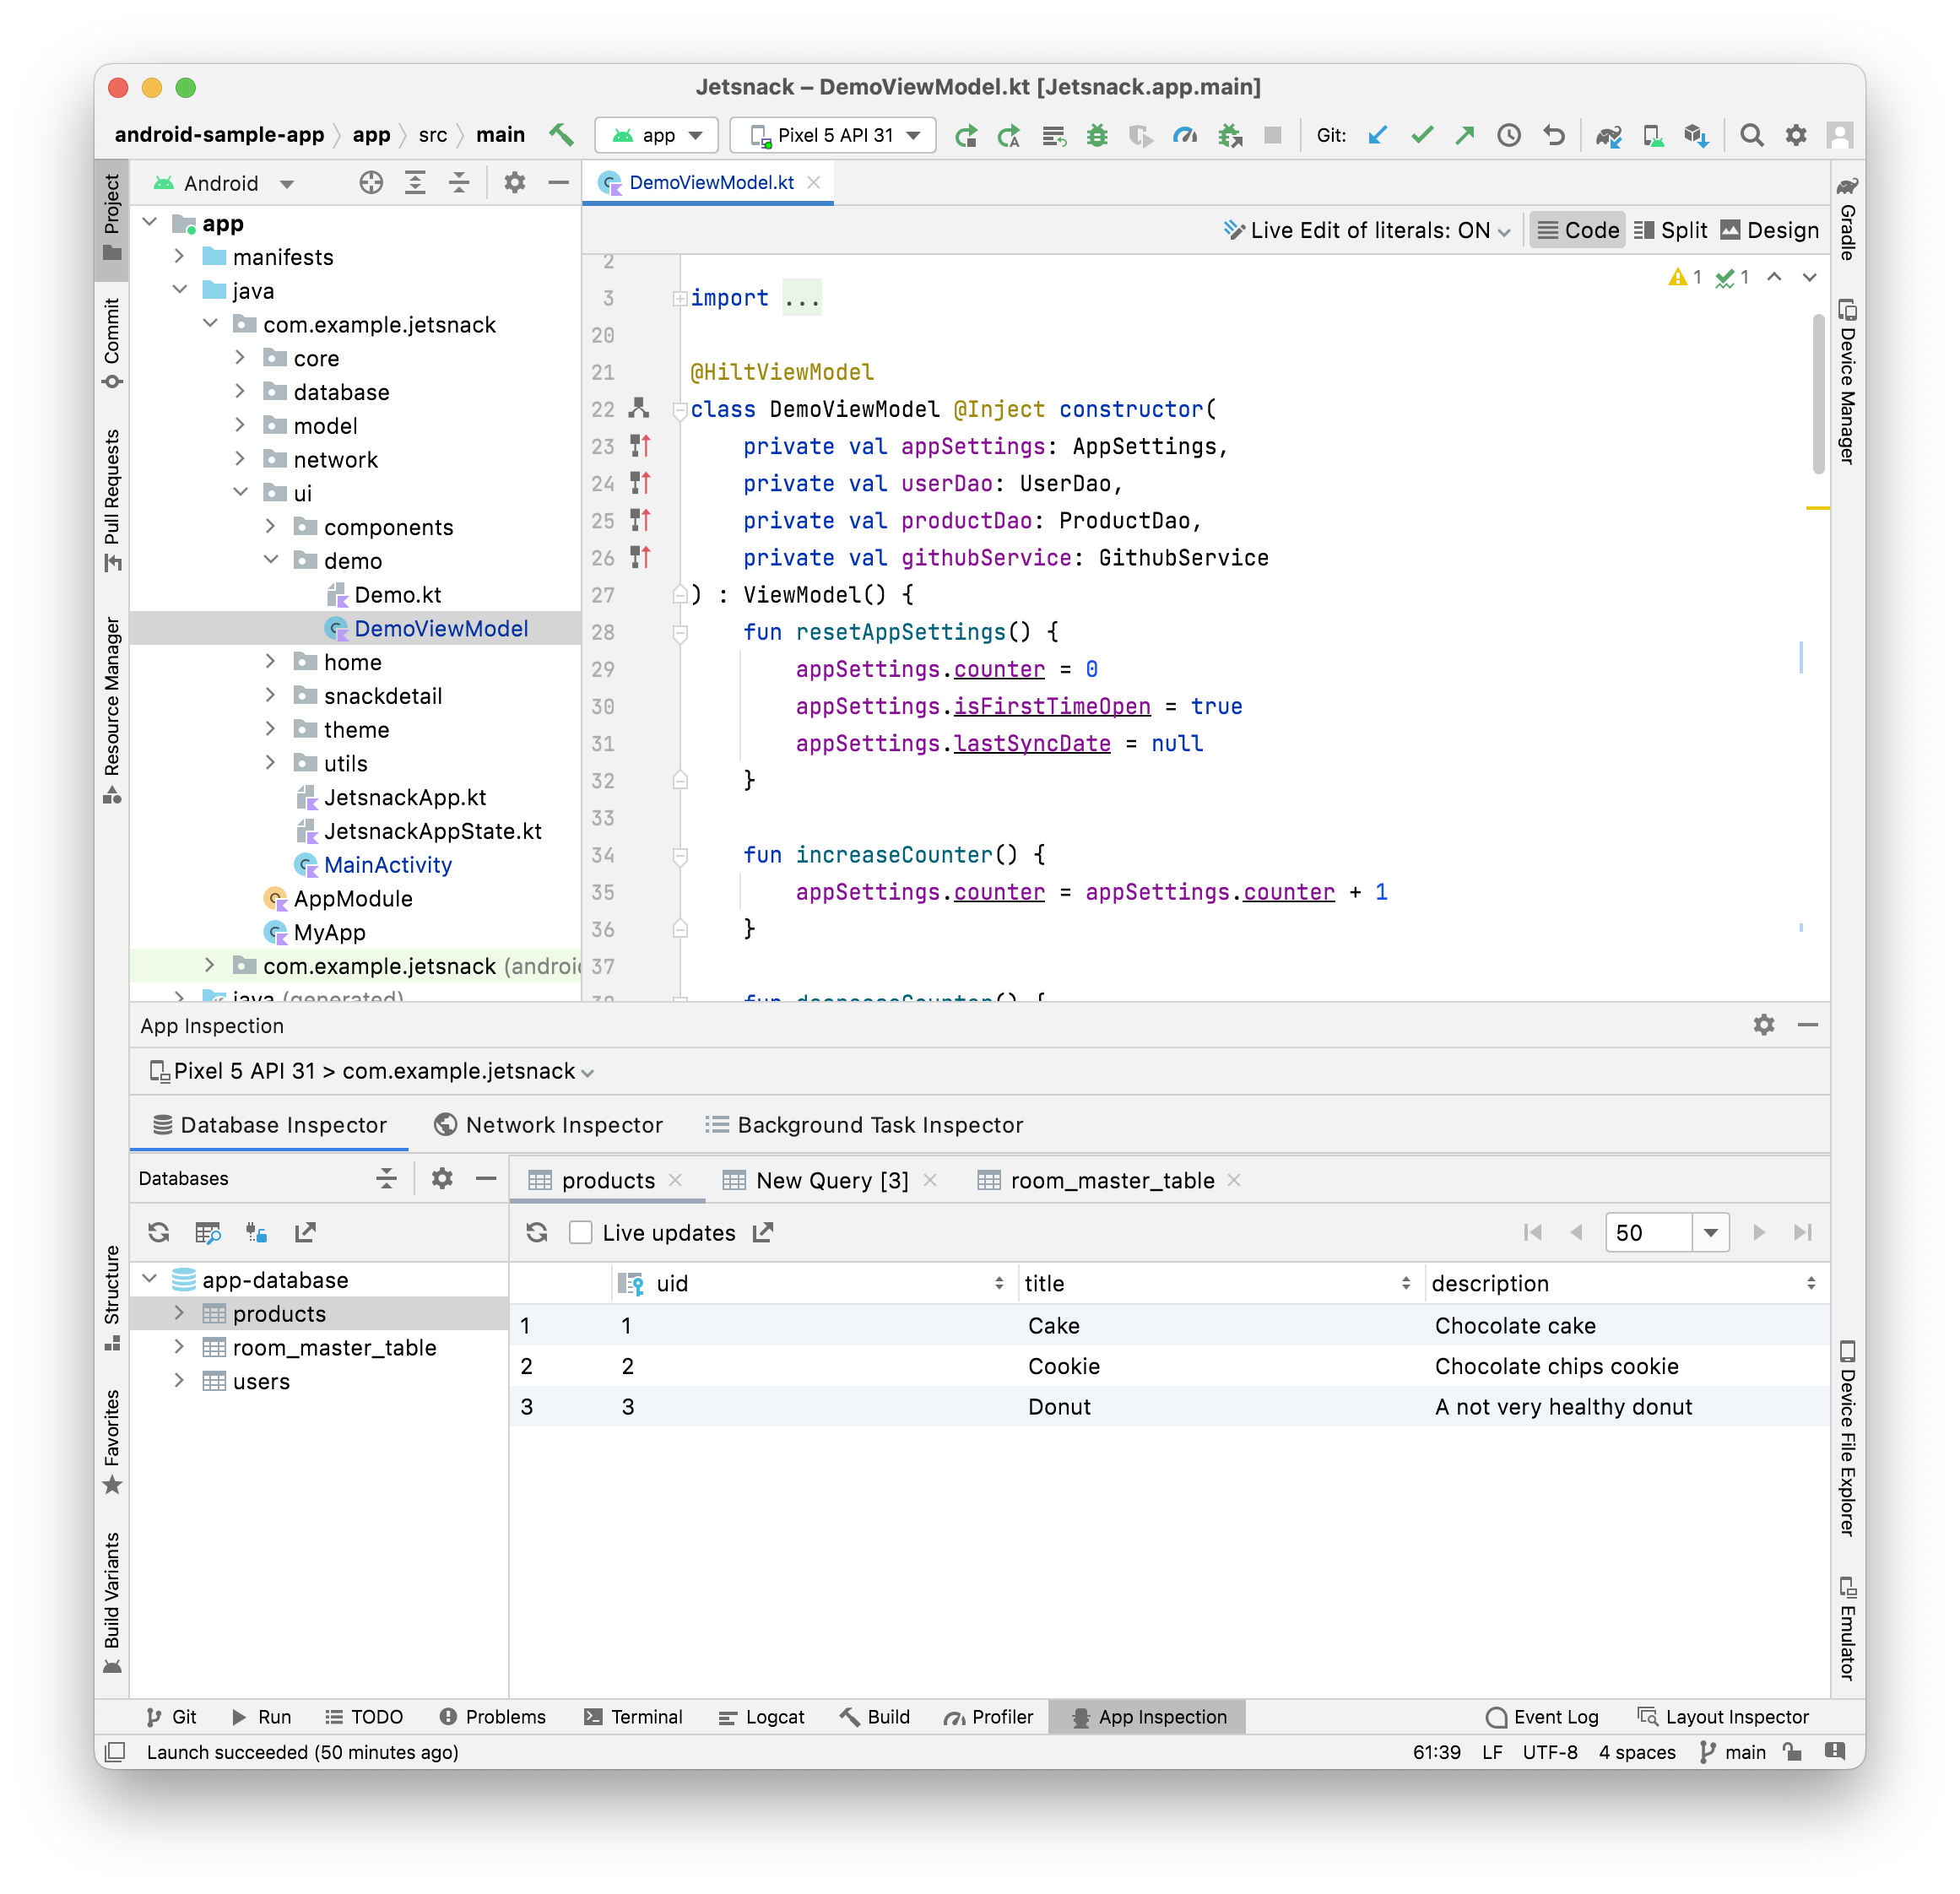
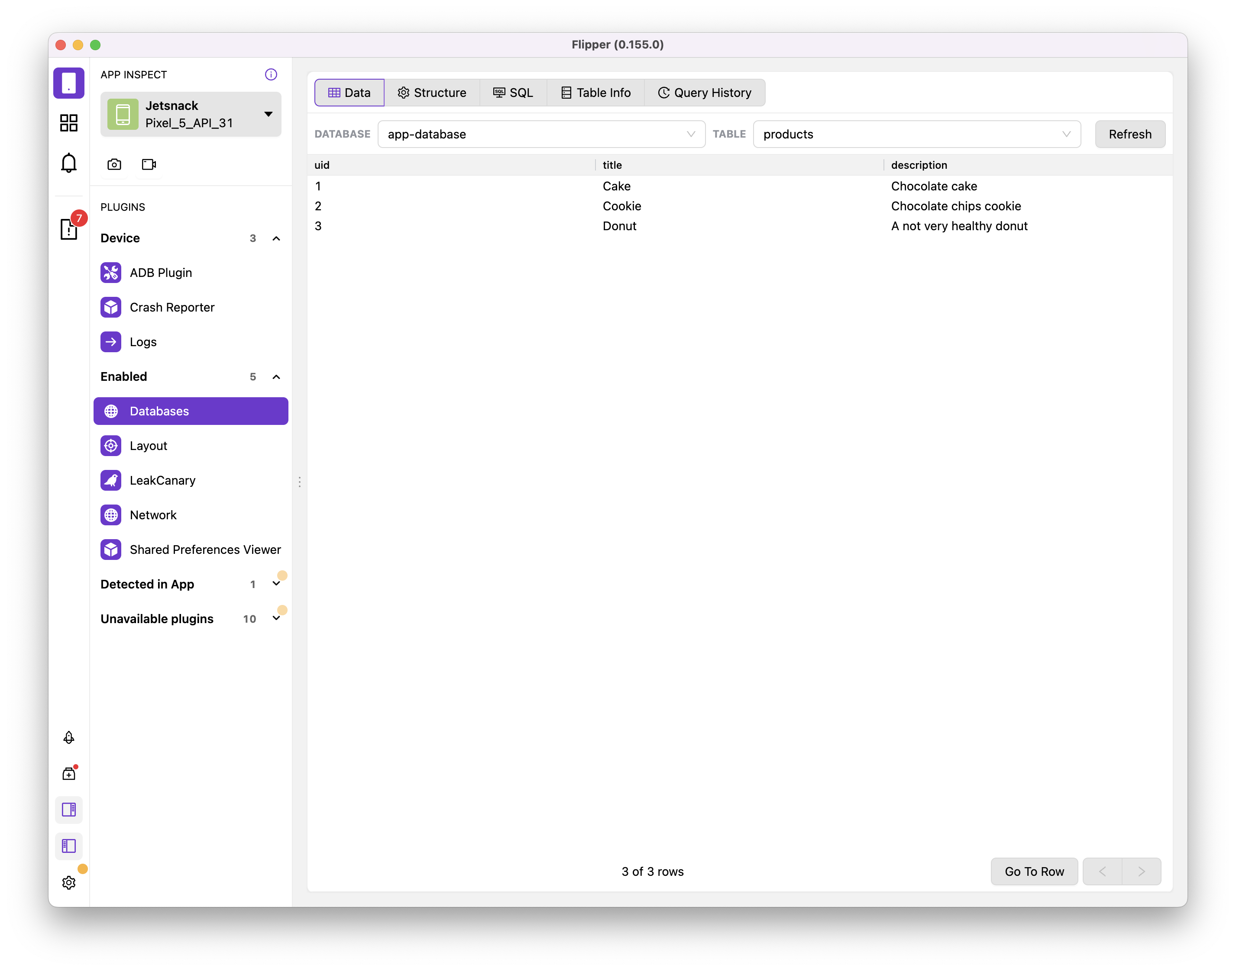
Databases

Slide 17
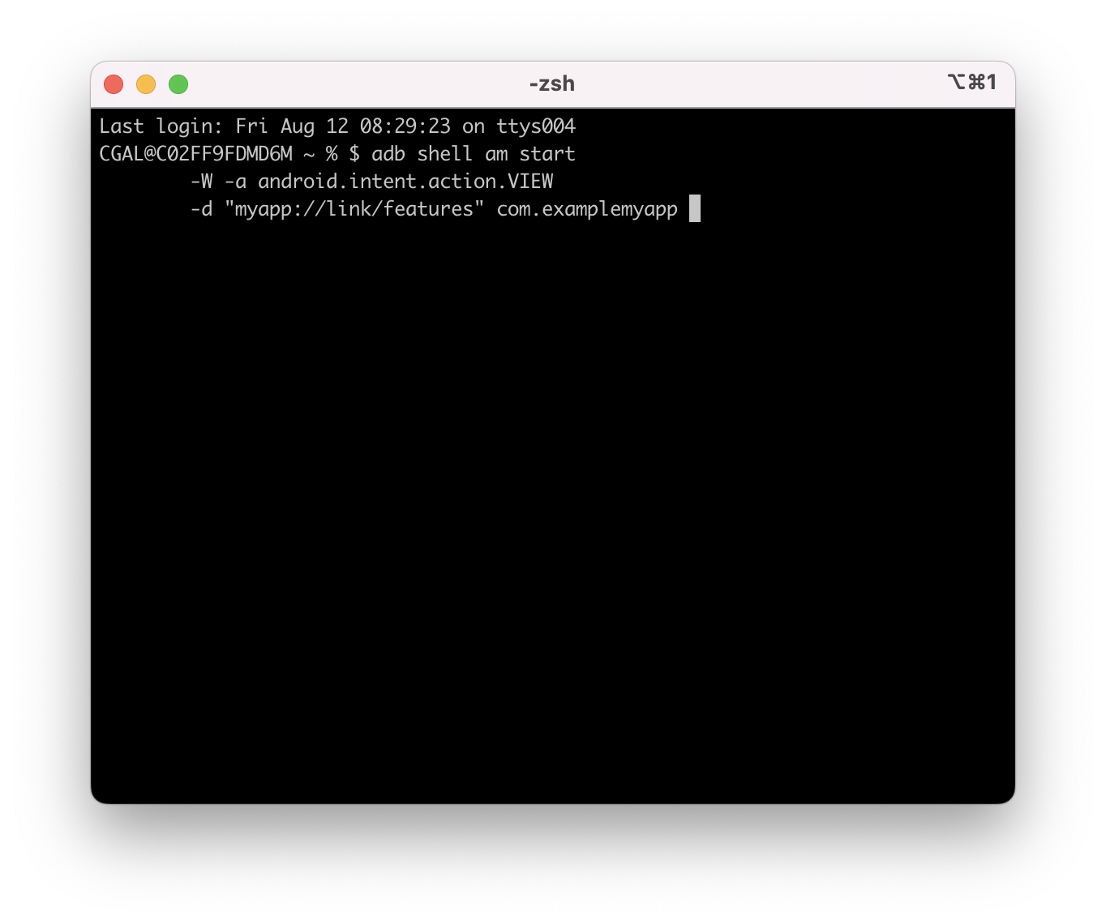
Navigation (deep links) - Android

Slide 18
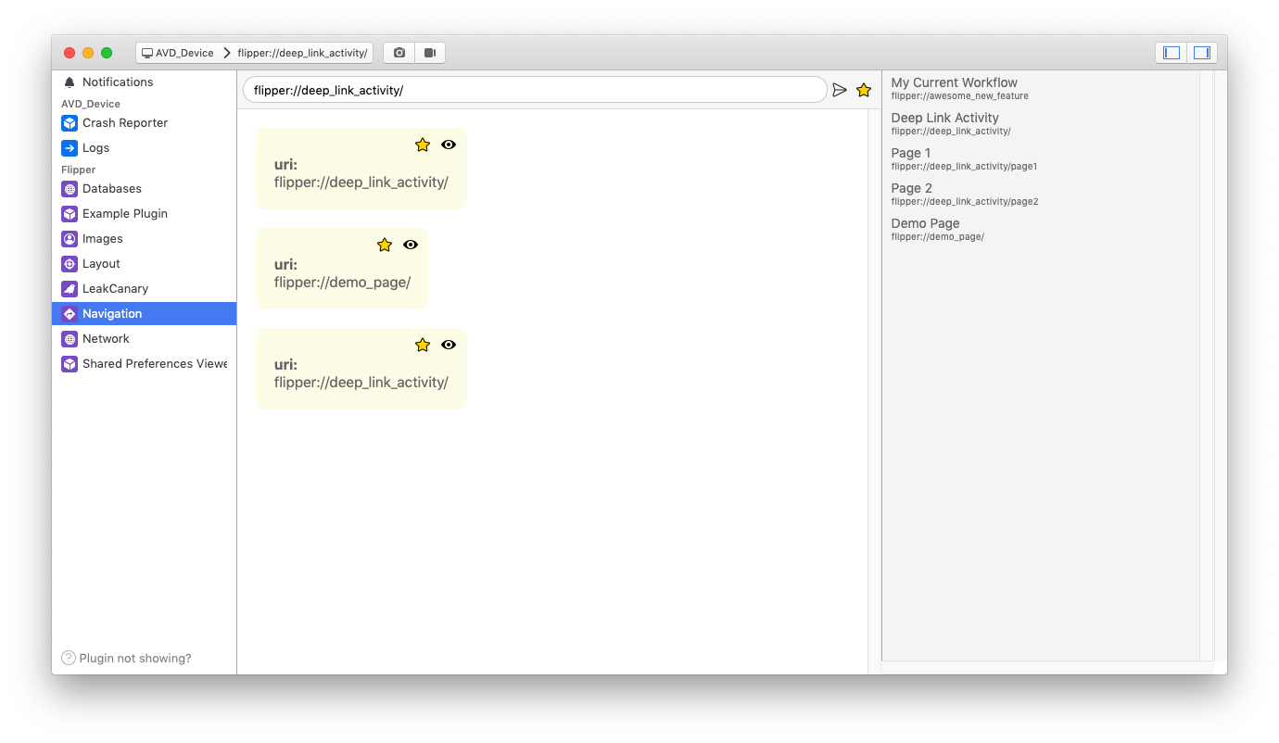
Navigation (deep links) - Flipper

Slide 19

DEmo

Slide 20
Creating your own plugins
Extending flipper

Slide 21
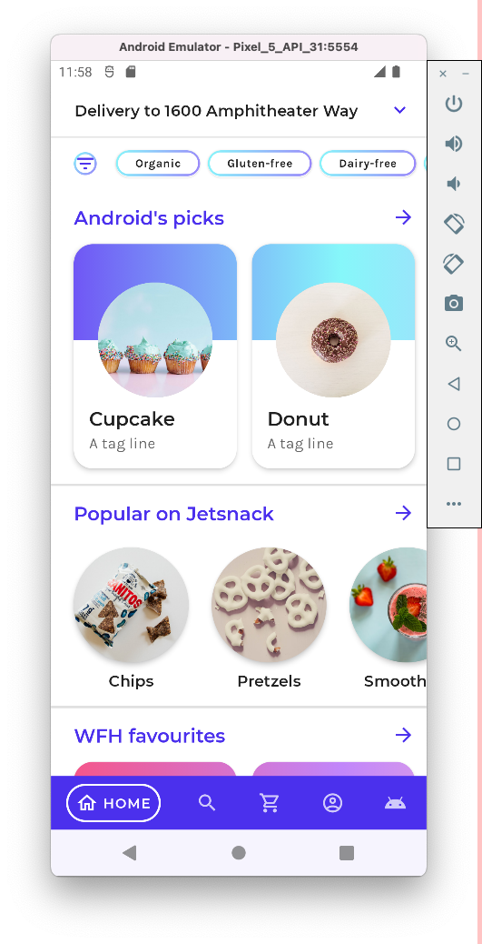
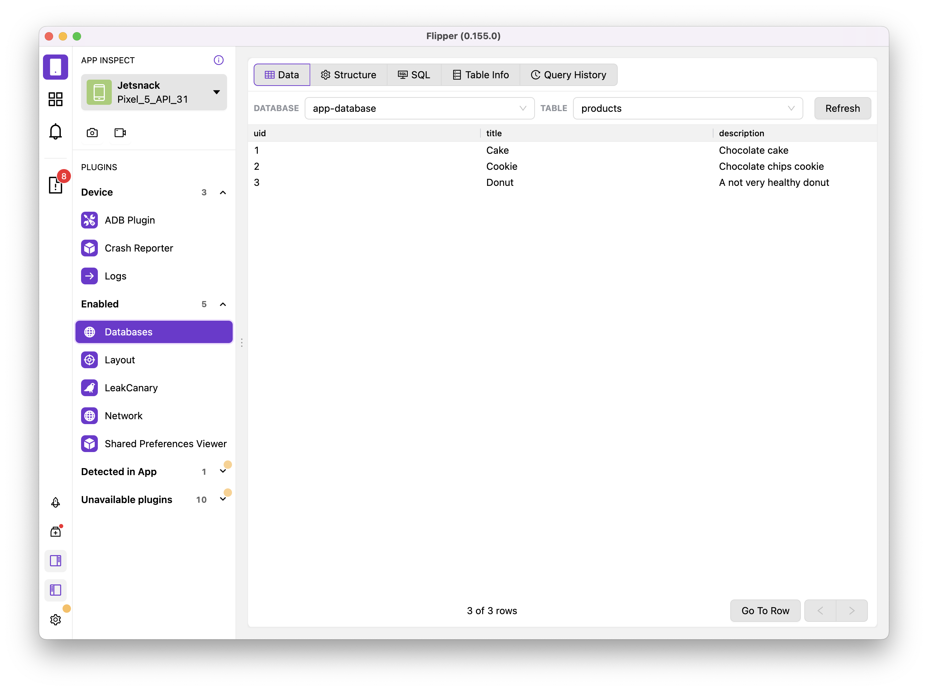
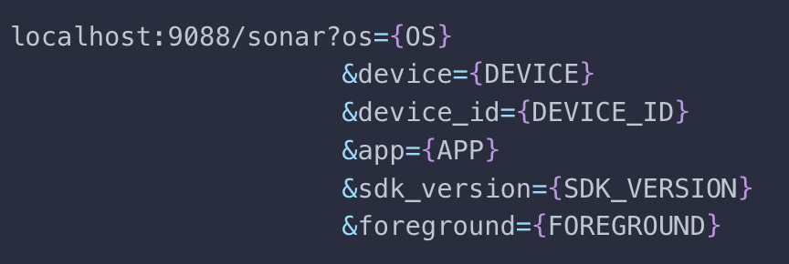
Creating plugins
Mobile client
Desktop App
Web Socket

Slide 22
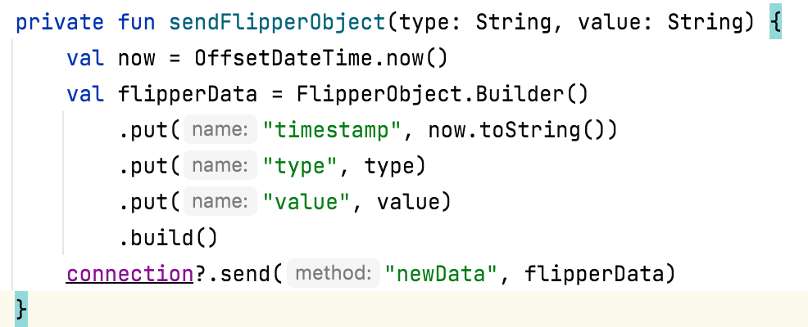
Client App
Send events with data

Slide 23
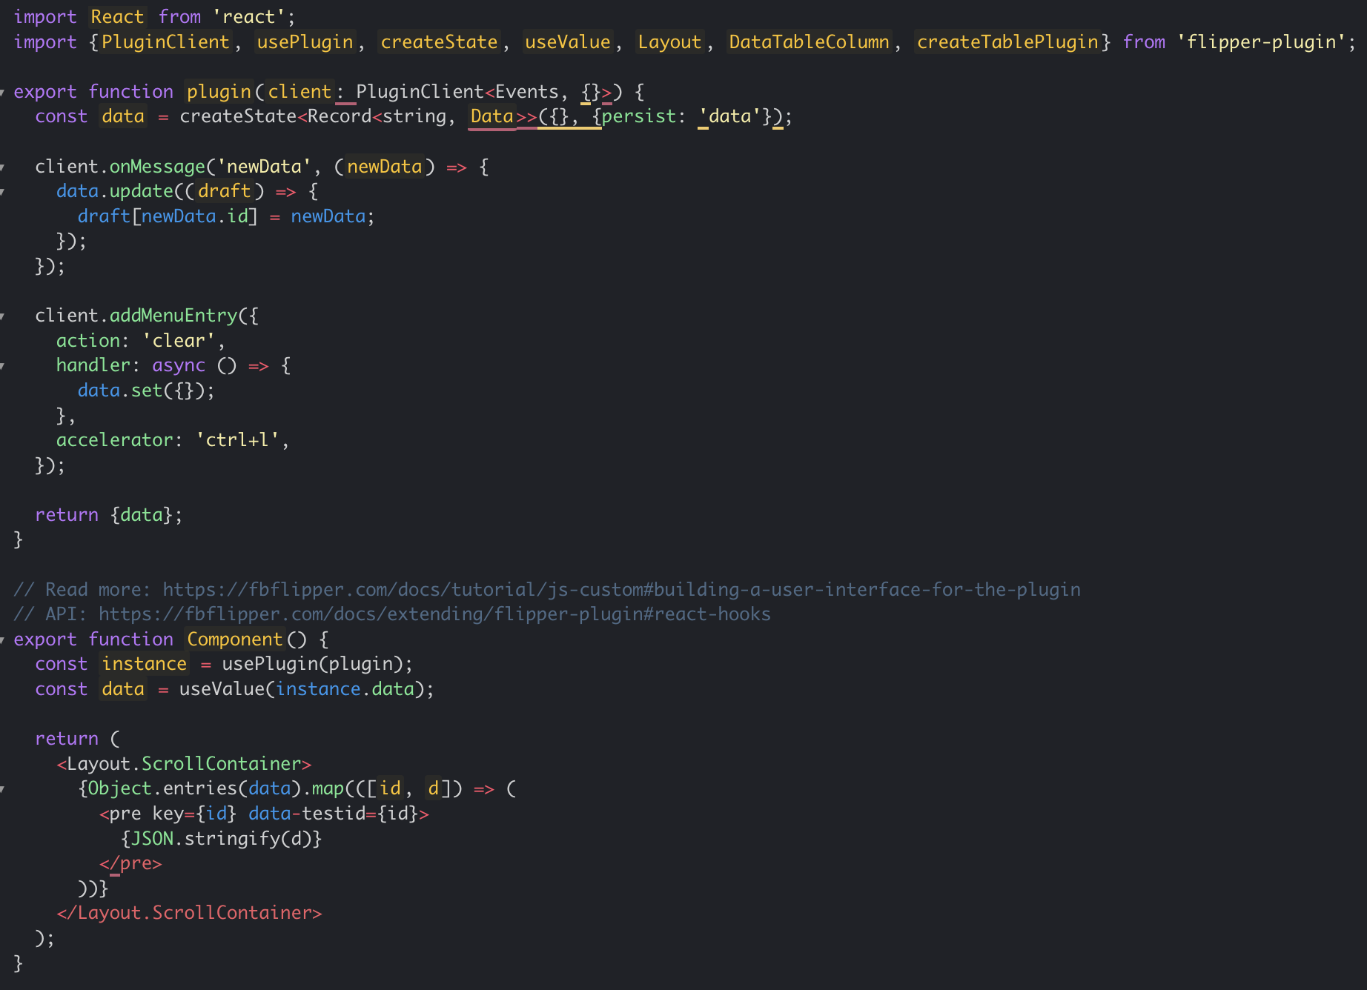
Desktop App
Listen to WebSocket messages
Build the UI using React

Slide 24

DEmo

Slide 25
RESOURCEs
Demo Code: https://github.com/cgal-capco/android-fb-flipper-demo
FB Flipper: https://fbflipper.com/
FB Flipper Repo: https://github.com/facebook/flipper

Slide 26



